Slide 1

Arduino Rover
Presented By:
Nithin U 811720104071
Mohamed Jameer 811720104061
Saran Shakthi 811720104092
This Photo by Unknown author is licensed under CC BY-SA-NC.

Slide 2

Agenda
Requirements and Analysis
Design and Coding
Operations and Outcome
Pros and Cons

Slide 3

Requirements
•Arduino Uno
•L293D Motor Driver
•TT Gear Motor and wheels
•Rubber Wheels
•Ultrasonic Sensor
•Proximity IR Sensor
•18650 Battery (3.7V Lithium Battery)
•18650 Battery Holder
•Acrylic Sheet
•HC05 Bluetooth Module
•DC Switch

Slide 4
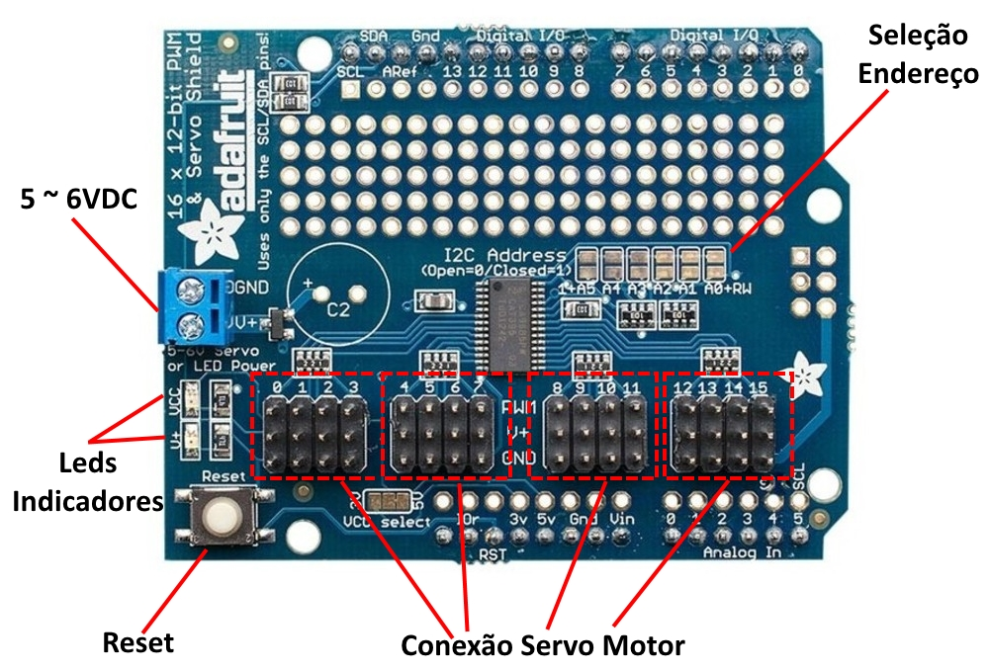
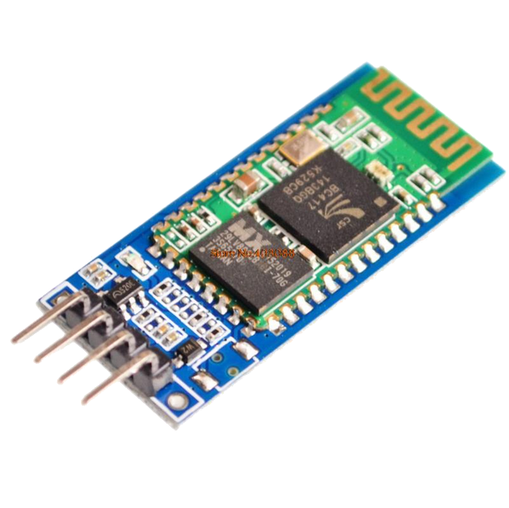
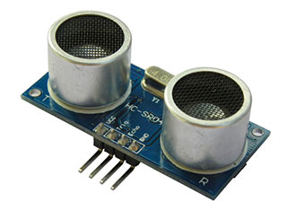
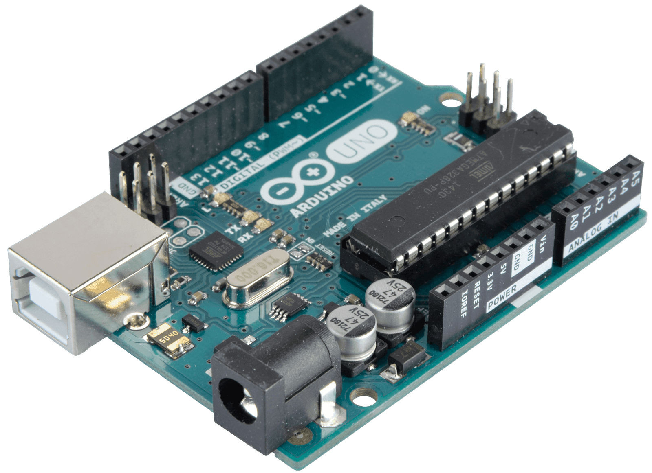
Main Components
This Photo by Unknown author is licensed under CC BY-SA.
Arduino Uno
Adafruit Motor Shield
UltraSonic sensor
Bluetooth Module

Slide 5
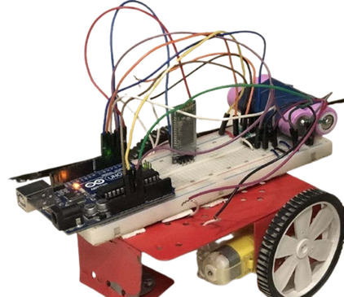
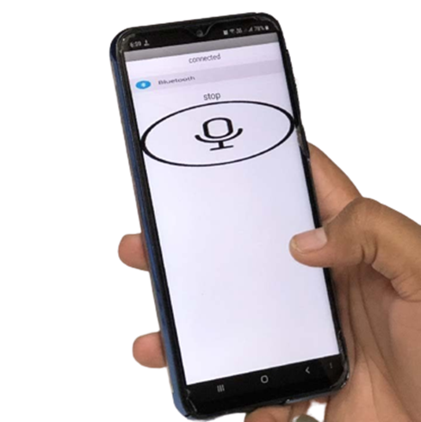
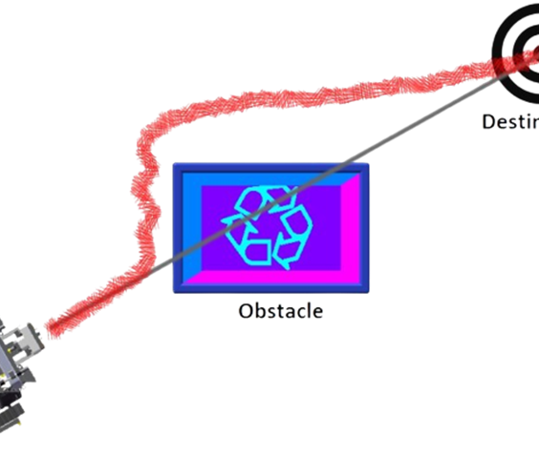
Analysis:
A Sample Arduino Robot to work under Human Voice Command and Need to Sense Obstacle to avoid crash.

Slide 6
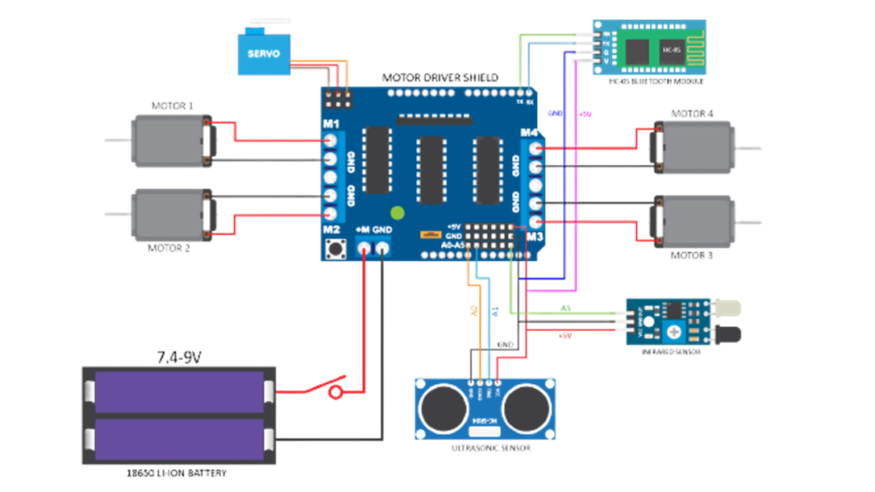
Design:

Slide 7

Modules:
Build Base and add Specifications
Assembling whole hardware Components
Make Rover to do some action
Add Code for Voice recognition and automatic sensing ability
This Photo by Unknown author is licensed under CC BY-SA-NC.

Slide 8
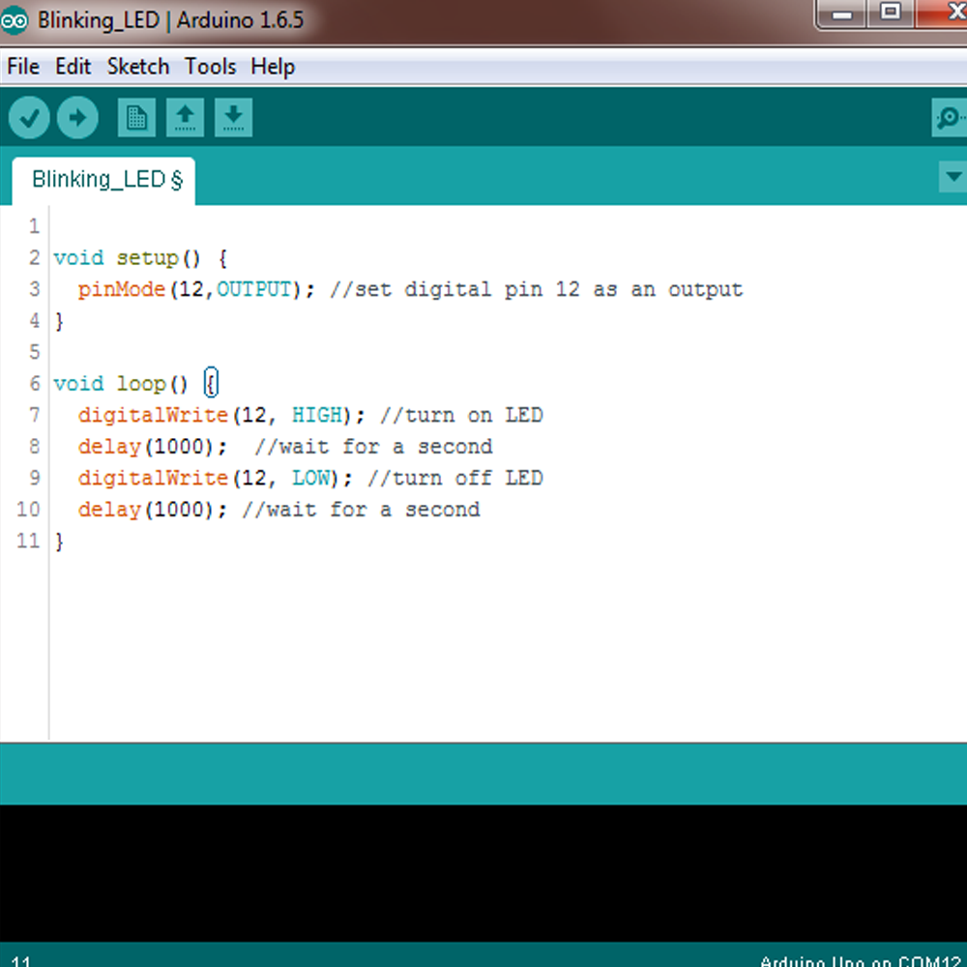
Coding
The coding screen is divided into two blocks. The setup is considered as the preparation block, while the loop is considered as the execution block.

Slide 9
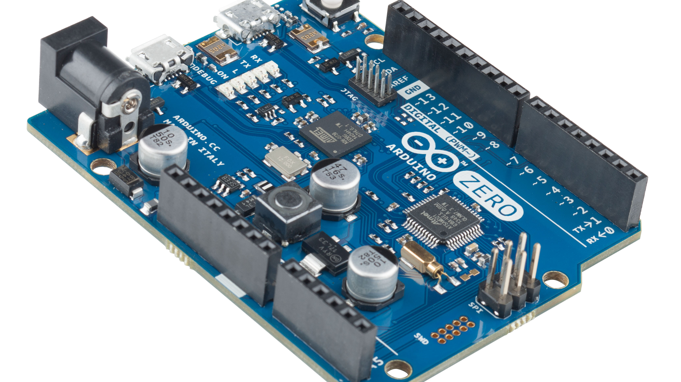
Operations
Arduino is an open-source electronics platform based on easy-to-use hardware and software. Arduino boards are able to read inputs - light on a sensor, a finger on a button, or a Twitter message - and turn it into an output - activating a motor, turning on an LED, publishing something online.
This Photo by Unknown author is licensed under CC BY-SA-NC.

Slide 10

OUTCOME
•Understand the value and importance of learning a coding language with IOT Devices.
•Be able to write a simple program in C and C++ with GUN Compiler and execute in projects.
•Transform a physical input into a digital input and analyze it.
•Understand the function of electronic sensors and components

Slide 11

Pros And cons
•Ready to Use with few Lines Of Code.
•Simple and Easy learning of code to instruct a machine.
•Great Effort Makes New Projects Over It and products are Reusable.
•large user community, free and broad ranges of libraries of codes, relatively low cost components.
•Structure Of Arduino is the main disadvantage as it cannot stick for big PCB boards. Suitable for project as small size.
•Many people has hesitate to provide cost for this project by thinking as low cost to get creative outcome.

Slide 12
REPORT
₹ This project Takes 2,680 Rupees for requirements .
⌛ Need Time Duration of 4 Months

Slide 13

Thank You Guided By: Mrs.S. RAHMATH NISHA

